Slide 1




Module: Business Research Methodologies
Module Lecturer:
Dr Uma Mohan

Slide 2



LECTURE 1
THE ROLE OF SOCIAL AND BUSINESS RESEARCH IN THE DECISION-MAKING PROCESS

Slide 3

GENERAL INTRODUCTION
Teaching Team:
Dr Uma Mohan
Preethi Nageswaran
Contact:
Uma.mohan@lsclondon.co.uk
ifrina.ikram@lsclondon.co.uk

Slide 4
Core Text books
Saunders, M, Thornhill, A, & Lewis, P (2019) Research Methods for Business Students, (8th. ed.) Pearson Education.
Easterby-Smith, M. et al (2018) Management and Business Research, (6th. ed.) Sage Publications
Gill, J and Johnson, P. (2010) Research Methods for Managers, (4th ed.) Paul Chapman.
Jankowicz, A. (2004) Business Research Projects, (4th ed.) Pearson Education.
Ghauri, P and Gronhaug, K. (2010) Research Methods in Business Studies, Pearson
Hart, C. (2018) Doing a Literature Review: releasing the research imagination, Sage
Ridley, D. (2012) The Literature Review: a step-by-step guide for students, Sage
Stokes, P. and Wall, T. (2014) Research Methods, Palgrave
Zikmund, W.G. and Quinlan,C. (2015) Business Research Methods, Cengage

Slide 5


Assessment
1. Assessment(s) covering 100%, will be uploaded to the portal and be available to you .
RM assignment which is the RM proposal

Slide 6

WHAT IS RESEARCH?
Notes:
6

Slide 7
“Something that people undertake in order to find out things in a systematic way, thereby increasing their knowledge”
Saunders, Lewis & Thornhill (2009 p.3 )
,

Slide 8
EXPANDED DEFINITION
Research is a purposeful, precise and systematic search for new knowledge, skills, attitudes and values, or for the re-interpretation of existing knowledge, skills, attitudes and values.
Key aspects need to be present for research:
Data collection and analysis should be systematic (based on logical relationships)
Data ( Findings) interpretation should be systematic
The purpose should be clear (find out things)

Slide 9


TYPES OF RESEARCH
SOCIAL RESEARCH
Purposeful, systematic and search for knowledge examining society’s attitudes, assumptions, beliefs, trends, stratifications and rules in order to determine Cause-and-effects, relationships between variables.
Economic research, Financial Research etc, but we look at -
BUSINESS RESEARCH
Undertaken in a systematic way to find out things about business and management.

Slide 10
THE ROLE OF RESEARCH IN THE DECISION-MAKING PROCESS
Two contrasting viewpoints emerge:
Research is not practical enough (guided by academic concerns) too theory based.
Too heavily based on practicality and not enough on theory

Slide 11
WHAT STIMULATES RESEARCH
When a specific opportunity arises
Personal experiences of the Managers
Research data has been collected in relation to social scientific theory

Slide 12
There is a need to strike the right balance
Gibbons et al. (1994) suggest that the process of knowledge production in contemporary society falls into two contrasting categories :
BASIC RESEARCH
APPLIED RESEARCH

Slide 13
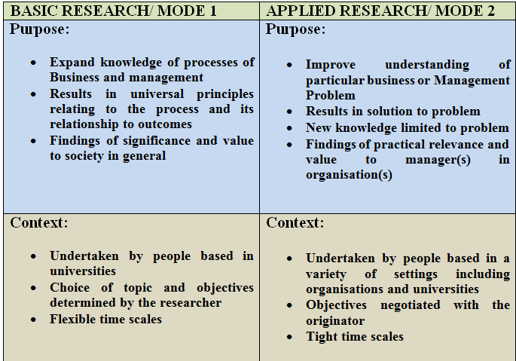
Gibbons et al. (1994) model 1 &2 Sources: Saunders et al. (2009); Esterby-Smith et al (2008)

Slide 14
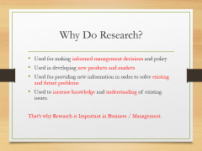
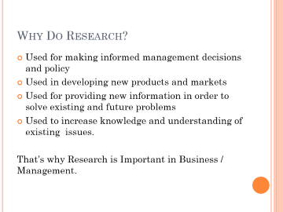
Why Do Research?
Used for making informed management decisions and policy
Used in developing new products and markets
Used for providing new information in order to solve existing and future problems
Used to increase knowledge and understanding of existing issues.
That’s why Research is Important in Business / Management.

Slide 15
The Research Process
The research process usually involves the following six stages:
Identifying a problem (or Research Question)
Reviewing the literature & making hypothesis
Designing the research
Conducting an experiment and/or collecting data
Data analysis
Interpretation, report writing and dissemination of findings.

Slide 16
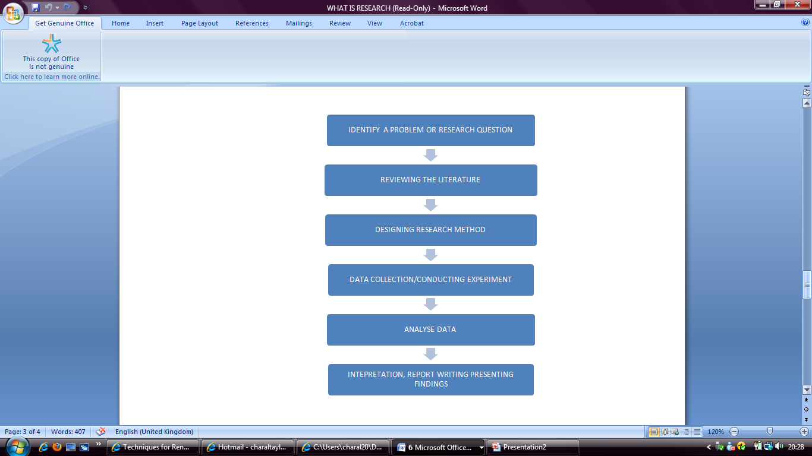
The Research process

Slide 17
CLASS ACTIVITY 1
If you had to conduct some business research now what would the topic be and what factors would have influenced your thought? Try and write an example that interests you.
Think about this as we develop the research process.

Slide 18
END OF LECTURE 1

